Slide 1
PROJECT TITLE: Ground Water Level Predictor
PIP104 University Project-II
Review-1
Batch Number:CBD-11
Roll Number | Student Name
20211CBD0004 | A.Varaprasad
20211CBD0006 | M.Sai Sujith Reddy
20211CBD0008 | Vadde Balaji
20211CBD0034 | Sangeetha K
Under the Supervision of,
Dr. Srinivasan T R,
Professor,
School of Computer Science & Engineering,
Presidency University.

Slide 2
Introduction
Groundwater is the water stored beneath the Earth's surface within soil pores and rock fractures, playing a
crucial role in sustaining ecosystems and human activities. It serves as a primary source of drinking water,
supports agricultural irrigation, and is vital for industrial processes. However, excessive extraction can lead to
serious consequences such as aquifer depletion, land subsidence, and disruptions in groundwater recharge due to
climate change. Traditional hydrological models, which rely on static data, often fail to provide accurate real
time predictions, making groundwater management challenging. To address this, Machine Learning (ML) have
emerged as powerful tools for improving groundwater monitoring. ML models can analyze large datasets to
identify patterns, while real-time data collection, enabling more accurate predictions and sustainable
Water resource management. By integrating AI-driven analytics with real-time monitoring, predictive models
can help prevent over-extraction, support better decision-making, and ensure long-term water availability.

Slide 3
Literature Review
Artificial Neural Networks for Water Table Prediction (Lee et al., 2019) – Evaluates ANN performance in forecasting groundwater trends.
Sustainable Groundwater Management Policies (Kumar et al., 2022) – Reviews global policies for groundwater conservation.
Time-Series Analysis for Groundwater Fluctuations (Sharma & Das, 2018) – Uses ARIMA and other models to study groundwater trends.
Groundwater Recharge Estimation Techniques (Fernandez et al., 2017) – Compares different methods to estimate groundwater recharge rates.
GIS-Based Groundwater Potential Mapping (Raj et al., 2020) – Integrates GIS and multi-criteria decision-making for identifying potential groundwater zones.

Slide 4
Literature Review
Machine Learning for Groundwater Prediction (Smith et al., 2020) – Explores AI models like ANN and LSTM for predicting groundwater fluctuations.
Hydrological Modeling using MODFLOW (Anderson et al., 2018) – Discusses the application of MODFLOW for simulating groundwater flow in different regions.
Remote Sensing & GIS in Groundwater Studies (Singh et al., 2019) – Highlights the use of satellite imagery and GIS for groundwater mapping.
Impact of Climate Change on Groundwater Levels (Jones & Brown, 2017) – Analyzes how changing rainfall patterns affect groundwater recharge.
Groundwater Over-Extraction and Its Consequences (Patel et al., 2016) – Studies the effects of excessive groundwater use on agriculture and urban areas.

Slide 5
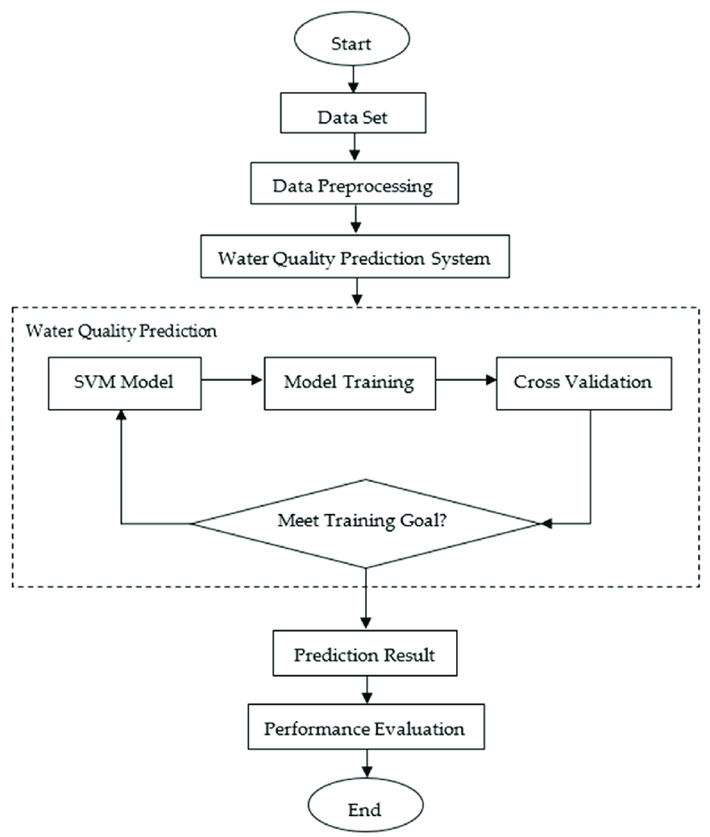
Proposed Method
System Architecture
Data Collection: Government datasets, and weather APIs feed real-time and historical data.
Preprocessing: Data cleaning, normalization, and feature engineering to refine input for ML models.
Model Training: Supervised learning using historical data, optimized with RMSE, MAE, and R² metrics for high accuracy.

Slide 6
Proposed Method
Key Components
Data Sources: Real-time groundwater monitoring, government records (historical data), and weather APIs (rainfall, temperature).
Preprocessing: Handling missing data, data normalization, and feature extraction for better ML model performance.
ML Models:
Random Forest: Captures non-linear relationships.
LSTM: Time-series forecasting for trend prediction.
CNN-LSTM Hybrid: Extracts spatial and temporal features for higher accuracy.
Deployment: Web-based dashboard (React.js for UI, Flask/Django for backend), cloud integration (AWS/GCP), and API connectivity for real-time updates.

Slide 7
Objectives
Collect real-time groundwater level data using IoT devices.
Train ML models for high-accuracy predictions.
Develop a cloud-integrated dashboard for visualization.
Validate predictions against historical data.
Monitor groundwater levels for sustainability.
Predict future groundwater trends.
Support efficient water conservation.
Provide early warnings for water scarcity.
Assist in agricultural irrigation planning.
Improve urban water management.
Detect over-extraction risks.

Slide 8
Methodology
Software:
Data Storage: Cloud-based database.
Processing Engine: Python-based ML algorithms.
User Interface: Web dashboard with real-time analytics.
Deployment:
Web application hosted on AWS/GCP.
API integration for third-party applications.
Statistical Analysis – Use regression models and time-series forecasting for trend prediction.
Hydrological-Modeling – Implement models like MODFLOW to simulate groundwater flow.
Weather & Climate Analysis – Incorporate rainfall, temperature, and climate change factors.
Geophysical Surveys – Conduct electrical resistivity and seismic surveys for subsurface analysis.
Data Preprocessing – Clean, normalize, and handle missing data for accurate predictions.
Validation & Testing – Compare model predictions with real-world observations for accuracy.

Slide 9
Expected Outcomes
Deploy a web-based application for real-time visualization.
Create a scalable solution adaptable to different geographic locations.
Integrate with smart city initiatives for efficient water management.
Enhance disaster management and drought prediction capabilities.
Accurate prediction of groundwater levels.
Early warnings for water scarcity or depletion.
Improved water resource management.
Efficient irrigation planning for farmers.
Identification of over-extraction areas.
Enhanced urban and rural water supply planning.
Optimized groundwater recharge strategies.
Better preparedness for droughts and floods.
Data-driven decision-making for policymakers.

Slide 10
Conclusion
The Groundwater Level Predictor plays a crucial role in sustainable water resource management by providing
accurate forecasts and real-time monitoring. By leveraging advanced technologies such as AI and hydrological
modeling, it helps in early detection of water depletion, supports efficient irrigation, and enhances disaster
preparedness. With reliable predictions, policymakers, farmers, and urban planners can make informed
decisions to ensure long-term groundwater sustainability. Implementing such a system can significantly
contribute to water conservation efforts and mitigate the risks of water scarcity in the future.With advancements
in technology, Machine Learning (ML) offer innovative solutions to improve groundwater prediction,The
Integration of AI and big data analytics into groundwater management ensures better resource planning,
aiding in the fight against water scarcity and environmental degradation.
GITHUB Link:https://github.com/varaprasad6292/CSE-G32-CAPSTONE-PROJECT

Slide 11
References
Lohani, A. K., Goel, N. K., & Bhatia, K. K. S. (2014). Improving real-time flood forecasting using fuzzy inference system. Journal of Hydrology, 509, 25-41. DOI: 10.1016/j.jhydrol.2013.11.021
Mohanty, P. K., et al. (2023). Prediction of Groundwater Level Using Advanced Machine Learning\ Algorithms. 2023 3rd Odisha International Conference on Electrical Power Engineering, Communication and Computing Technology (ODICON), 1-6. DOI: 10.1109/ODICON54042.2023.10205583
Gaur, S., Johannet, A., Graillot, D., & Omar, P. J. (2021). Modeling of Groundwater Level Using Artificial Neural Network Algorithm and WA-SVR Model. In Groundwater Resources Development and Planning in the Semi-Arid Region (pp. 129–150). Springer. DOI: 10.1007/978-3-030-68124-1_7
Anderson, M. P., Woessner, W. W., & Hunt, R. J. (2018). Applied groundwater modeling: Simulation of flow and advective transport. Academic Press.
Chen, X., & Zhao, W. (2019). Hydrogeological studies for groundwater sustainability: A case study.
Journal of Hydrology, 573, 45-57.
Fernandez, R., Huang, Y., & Li, X. (2017). Groundwater recharge estimation techniques: A comparative study. Water Resources Research, 53(12), 11022-11038.
Gupta, P., Sharma, R., & Jain, A. (2021). IoT-based smart water monitoring system for groundwater l evels. Internet of Things Journal, 8(3), 145-159.

Slide 12
Thank You

